Slide 1

Container-Tracking & Environmental-Data-Collection
Luca A. Gekle, Maximilian S. Kampl, Marko D. Schrempf
24. Februar 2025
DI (FH) Günther Hutter, MSc. DI Dr. Georg Judmaier
HTL Leoben
Notes:
Mündlich überliefert:
Motivation der Themenwahl
Erläuterung der Problemstellung
Erläuterung des Lösungsansatzes

Slide 2
Table of content
Problem
Goals
Partner/Conceptual formulation
SDGs
Allocation of tasks
Progress
Project management

Slide 3
Problem
a total of 250 million containers are transported worldwide every year [1]
2.500.000 containers are damaged [2]
1566 are lost [1]
25% are temperature-controlled [3]
we want to enable customers to react to special conditions through continuous monitoring

Slide 4
Goals
tracking of containers during overseas transport
GPS tracking
collection of environmental data for a specific container
temperature
humidity/pressure
vibration
provision of historical environmental data per container
development of hardware prototypes for a proof of concept
modern user interface for querying and visualizing the recorded data

Slide 5
Partner/Conceptual formulation
HTL Leoben
container tracking
building prototypes
determine positioning
read out environmental data
persist data
display data in web application
Notes:
Mündlich überliefert:
Motivation der Themenwahl
Erläuterung der Problemstellung
Erläuterung des Lösungsansatzes

Slide 6










SDGs
Notes:
3
8
9
12
14

Slide 7

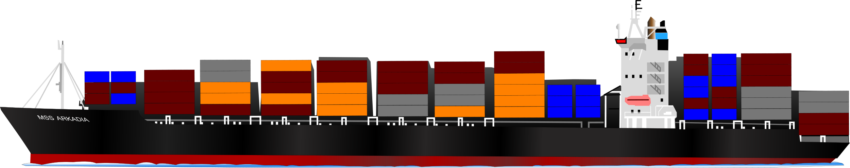
Allocation of tasks

Slide 8

Luca Alexander Gekle
Frontend
Graphs
Simulator
Luca A. Gekle

Slide 9
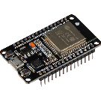
Hardware
Sensors
Data transfer
Maximilian S. Kampl

Slide 10
Hardware
Sensors
Data transfer
Maximilian S. Kampl

Slide 11
Hardware
Sensors
Data transfer
Maximilian S. Kampl

Slide 12

REST
Server
Databases
Marko D. Schrempf

Slide 13
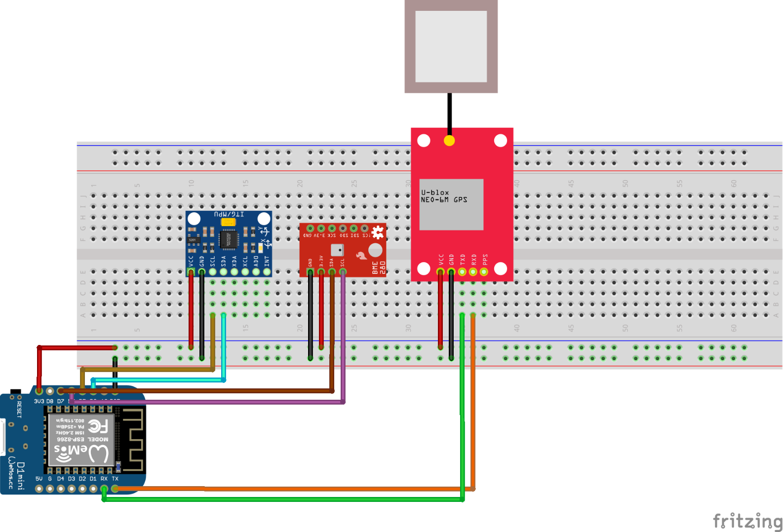
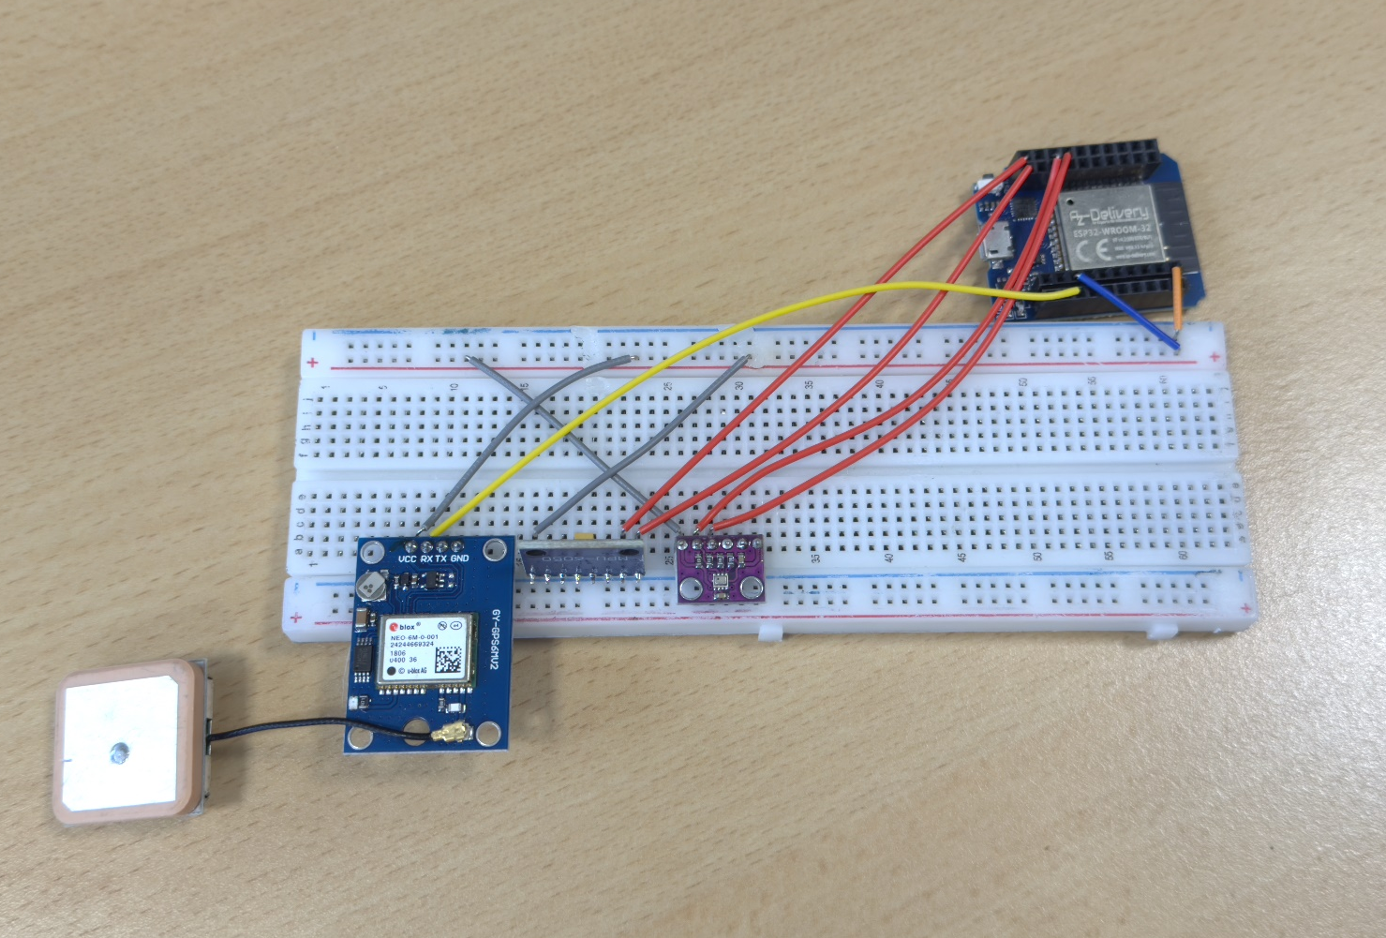
Progress - Kampl
hardware research
soldering
data acquisition/transmission
ArduinoIDE --> PlatformIO
mesh network

Slide 14
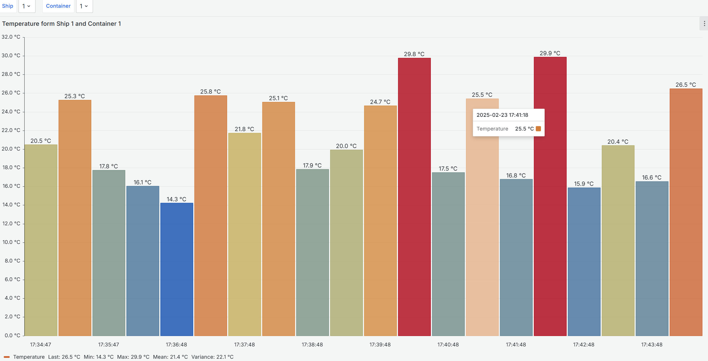
Progress - Schrempf
databases
REST interface
authentication
data visualization

Slide 15
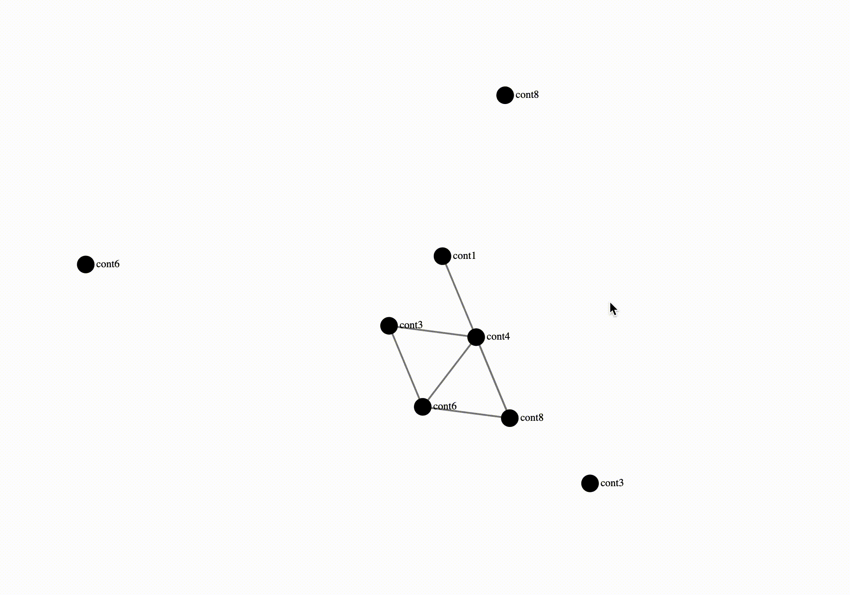
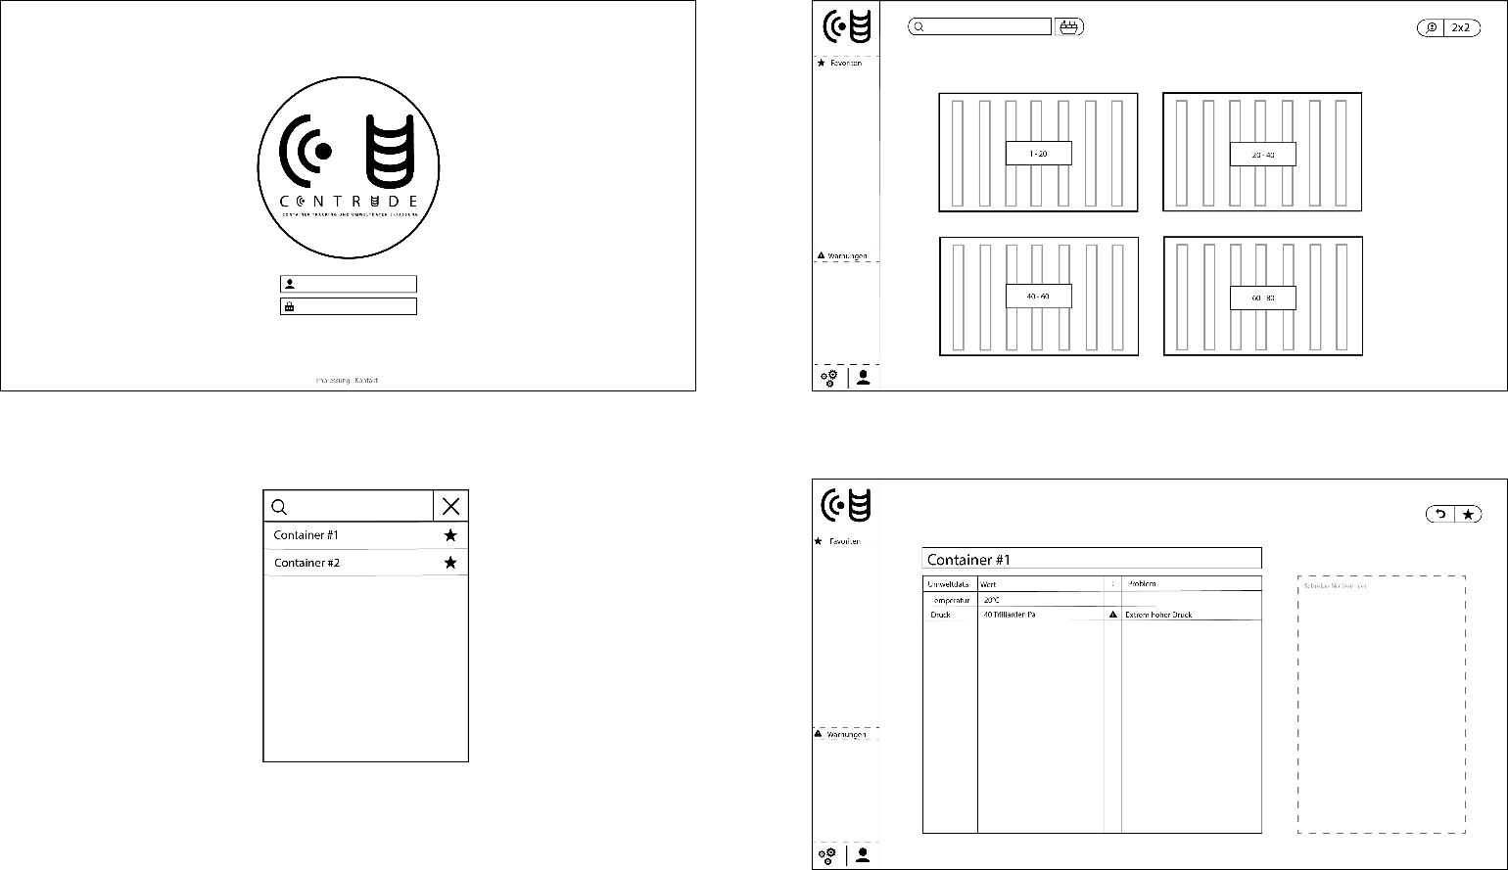
Progress - Gekle
website layout
simulation
directed-draggable-graph
positioning algorithm
first website design
Notes:
NICHT LÖSCHEN!!!!!
NICHT LÖSCHEN!!!!!
NICHT LÖSCHEN!!!!!
NICHT LÖSCHEN!!!!!
NICHT LÖSCHEN!!!!!
NICHT LÖSCHEN!!!!!
NICHT LÖSCHEN!!!!!
NICHT LÖSCHEN!!!!!
NICHT LÖSCHEN!!!!!

Slide 16
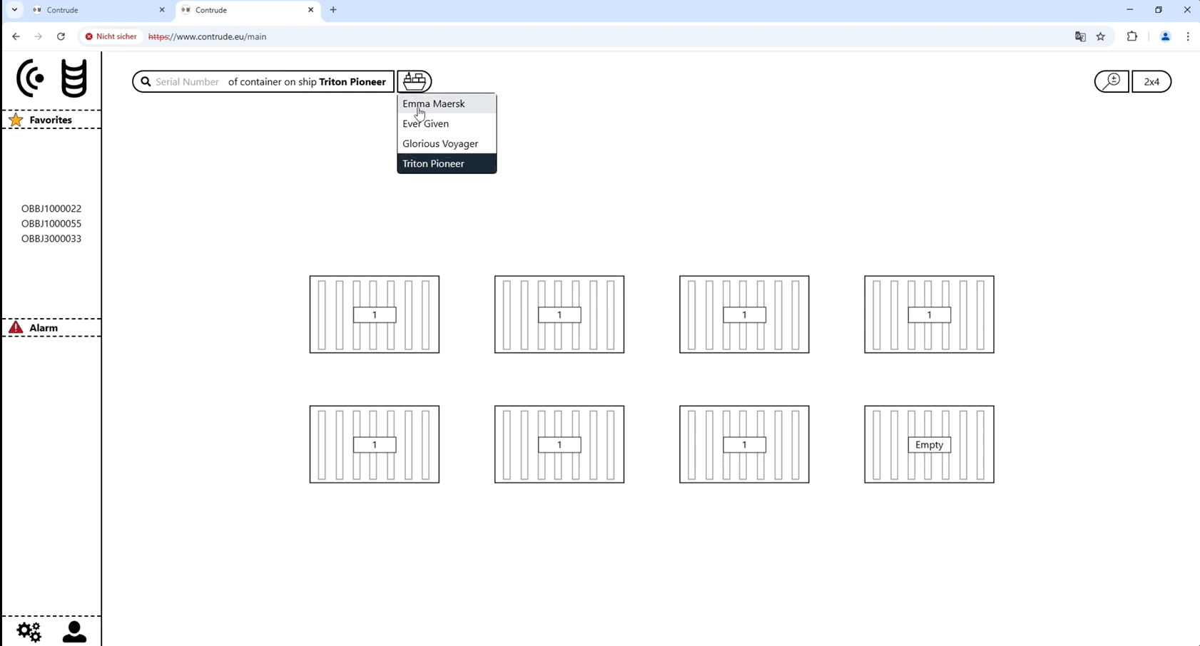
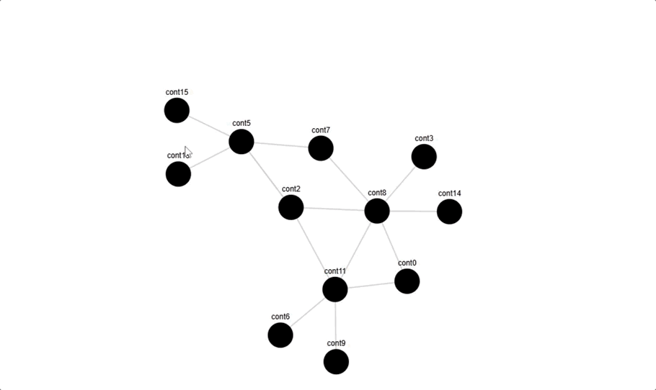
Progress - Gekle
website
login-Page
main-Page
detail-Page
link website with backend
dragable graph (DG)
color
code for creating the JSON files

Slide 17
Progess – Gekle

Slide 18
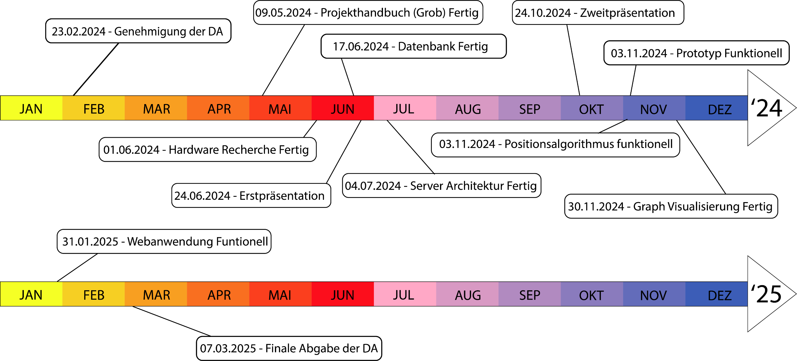
Project management – Milestones gantt diagram

Slide 19
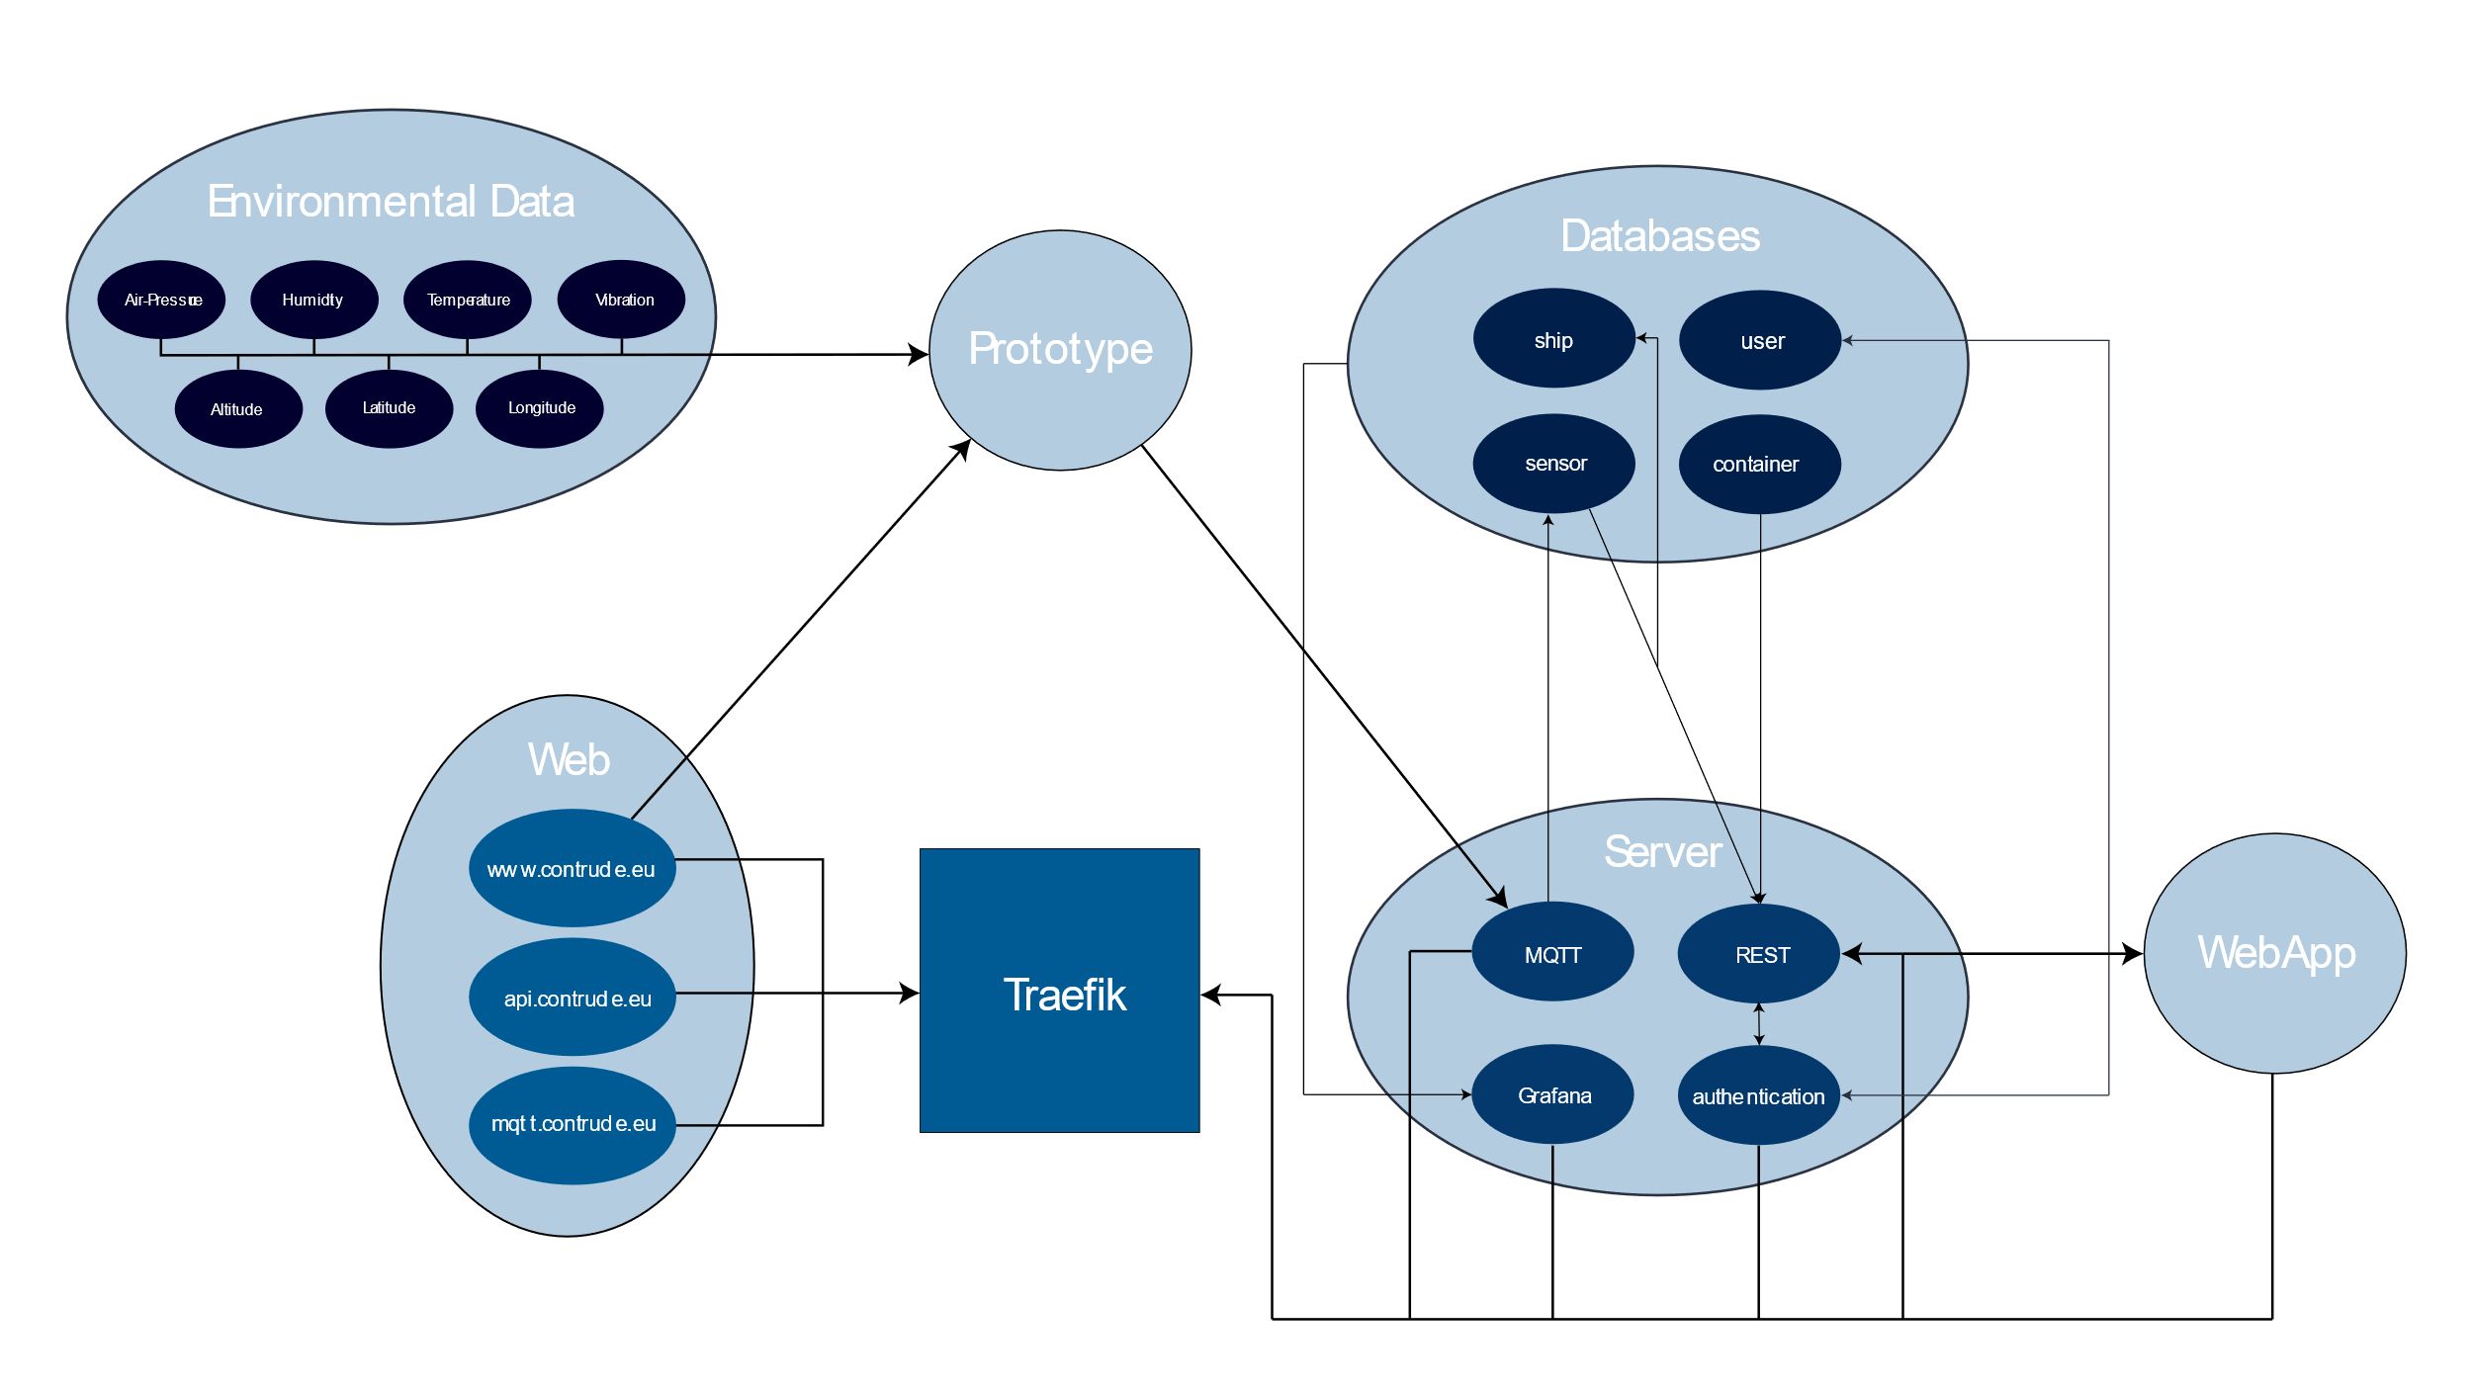
Project management - Server structure

Slide 20
Project management - Cost estimation
fictitious salary
€ 2.192,25 per person
€ 6.576,75 in total
hardware
€ 60,40 per person
€ 181,19 in total
€ 81,19 for hardware
€ 100 for printing the DT

Slide 21
Literature
REST API Design Rulebook - O’Reilly Media
Elektrische und elektronische Messtechnik – Hanser
Automatisierungstechnik – Europa Lehrmittel
ChatGPT
Data sheets
Esp32, Arduino Nano, Raspberry Zero
BME280
GY-NEO6MV2

Slide 22
Additionals

Slide 23
Project management - Milestones
2024-02-23: Approval of the DT
submission of the application by the students
DT documentation has been completed and signed
2024-05-09: Project plan rough draft completed
objectives filled out
project plan filled out
2024-06-01: Hardware component research completed
determination of components
price calculation
schedule calculation

Slide 24
Project management - Milestones
2024-06-17: Databases ready
general container information
sensor data
2024-06-24: Initial presentation of the DT
summarise progress
create Gantt chart
2024-07-04: Server architecture ready
server is ready for use
REST interface
access can be granted from anywhere

Slide 25
Project management - Milestones
2024-09-04: Prototype functional
hardware components purchased and delivered
soldering the components
data transmission via MQTT
2024-10-23: Second presentation of the DT
summarise progress
2024-11-03: Position algorithm functional
approximate position of the container
determine distance to neighboring containers

Slide 26
Project management - Milestones
2024-11-30: (Directed Draggable) Graph Visualisation
visualise container distances to others
movable nodes
2025-01-31: Web application functional
data query possible
attractive GUI
2025-03-07: Final submission of the DT
proofread
all three subtopics completed
DT submitted

Slide 27
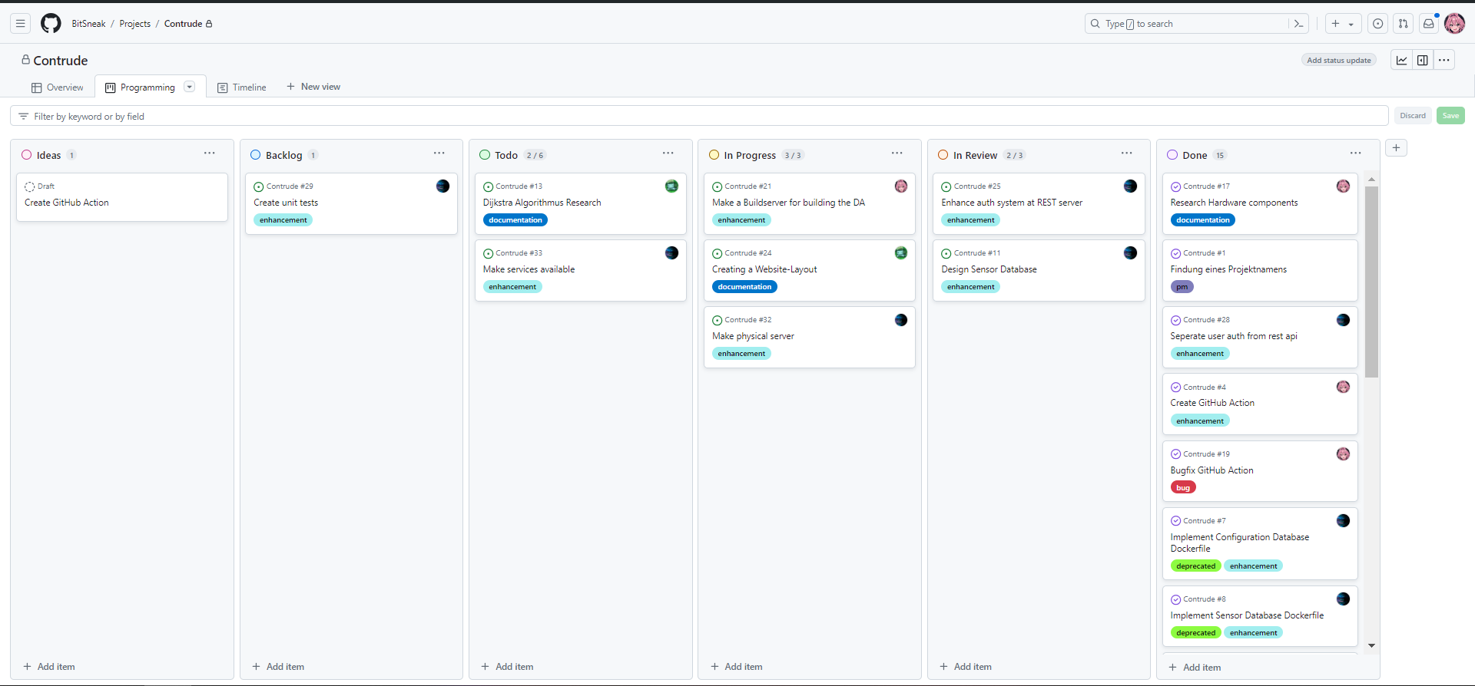
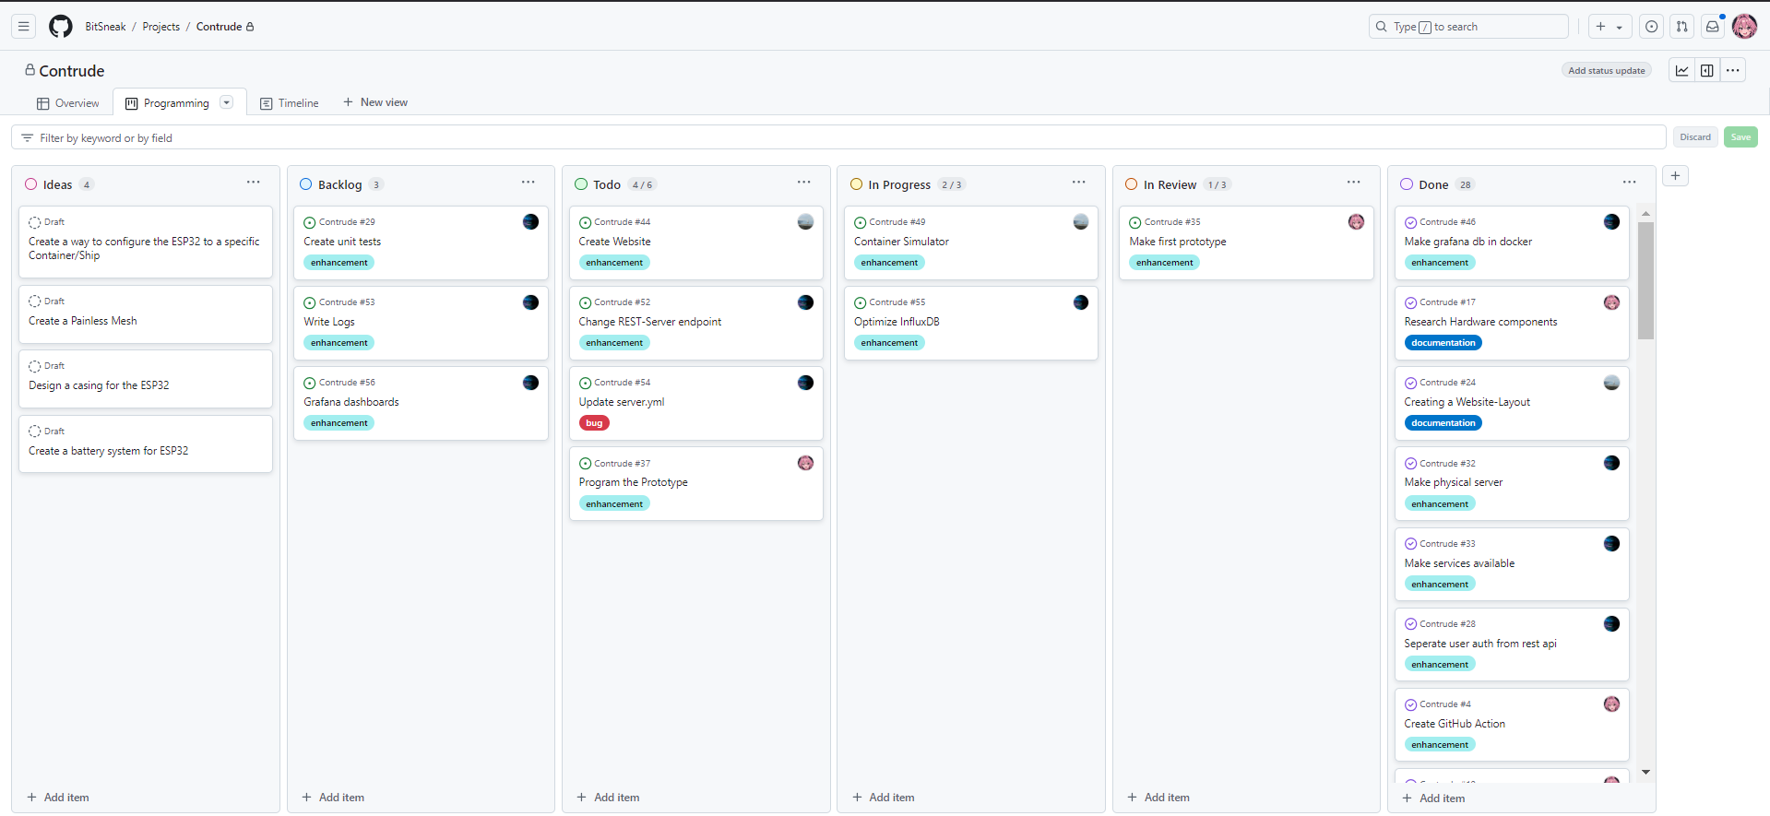
Project management – How it is lived

Slide 28
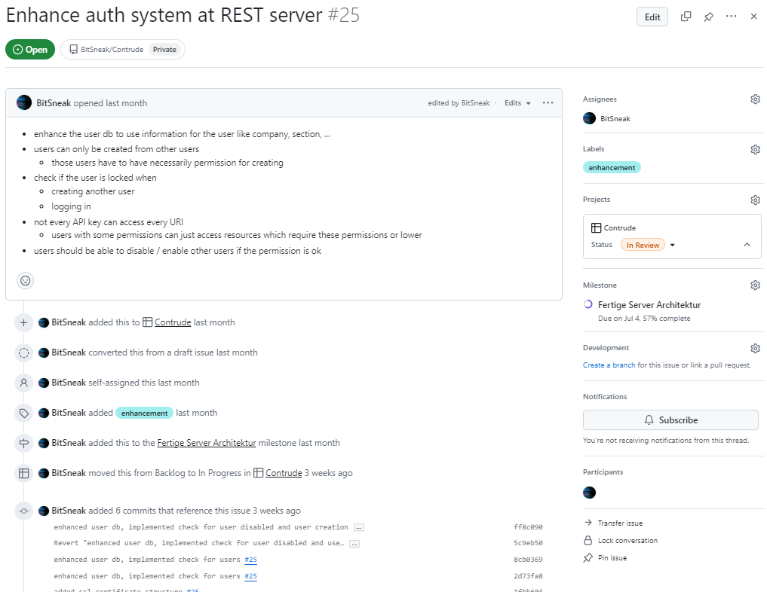
Project management – How it is lived

